Slide 1
Crime & real estate
Presented by:
paul Aggarwal
Nadia Alimetov
David Martinez

Slide 2


We were interested to determine if a relationship exist between the cost of real estate in New York City and the rate of crimes committed over a 5 year period, between 2012 and 2017:
Which borough has the costliest real estate?
Which borough has a high rate of crime relative to others?
Has any borough seen a decrease in crime?
Does crime affect real estate demand?

Slide 3
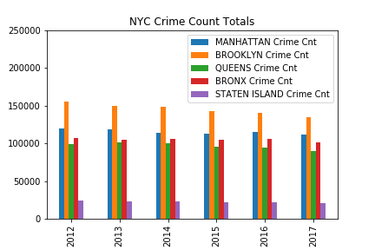
Crime rates per borough
Brooklyn
Manhattan
Bronx
Queens
Staten Island

Slide 4
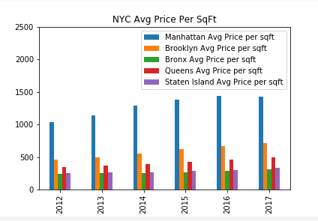
Average real estate prices per Sq ft
Manhattan
Brooklyn
Queens
Staten Island
Bronx

Slide 5
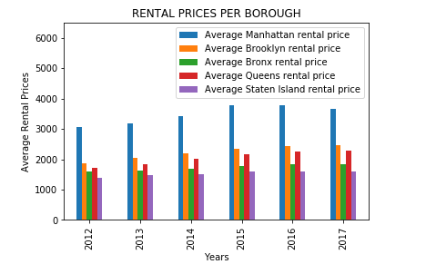
Average rental prices
Manhattan
Brooklyn
Queens
Staten Island
Bronx

Slide 6
Our results & interpretation:
manhattan crime has decreased 6.93% but rent and Price per SqFT has spiked 19.34% and 38.39%, respectively.
brooklyn crime has decreased 12.98% but rent and Price per SqFT has spiked 32.25% and 55.79%, respectively.
While there is an inverse relationship between the rate of crime and the cost of real estate in new York city, the significant margin between the two tells us there is more to the story.

Slide 7
Survey
We asked New York City residents to rank their reasoning for living in the Big Apple. Here were the four choices:
Work/Economic Opportunity
Safety
Big City Experience
Environment (Health)
Education

Slide 8
Survey Results & Conclusion
90% of respondents listed either “Work/Economic Opportunity” or “Big City Experience” as their top primary reasons for living in NYC, with ”Safety” or “Environment” consistently listed as the bottom two.
New York City residents are willing to pay a premium for the opportunity to earn a decent living or just to say “I live/lived in New York City”.

Slide 9
New skills:
challenges:
Scrubbing the data
Determining the appropriate graphs to utilize
Search for usable metadata
Discovered new programming libraries
Developed an eye for useful data
Effective collaboration

